Slide 1


E-COMMERCE CONSUMER AND PURCHASING BEHAVIOUR
CUSTOMER JOURNEY
SALES + SERVICE
BUSINESS INSIGHT
E-Commerce Consumer & Purchasing Behaviour
Notes:
Good morning everyone. Our presentation uses a customer journey approach. Instead of explaining every chart separately, we tell the story from click to return. We want to understand who buys, how they buy, what happens after the purchase, and what the business should do next.

Slide 2





OUR TEAM
NURUL ATHILAH
Business Strategy Consultant
SYAZANA AQILA
Customer Experience Manager
NUR AISYAH
Data Analyst
NURR AIN
E-Commerce
Operation Manager
HANANI LIYANA
Sales & Marketing
Manager
E-Commerce Consumer & Purchasing Behaviour

Slide 3
DATA BACKGROUND
What Is the Project Background?
Online shopping has changed how people buy products and why business must understand customer behaviour.
Study focus: Understanding Online Shopping Behaviour
This project explores how customer browse, choose, purchase, and interact in e-commerce environments, and why
This patterns matter for business performance.
How shopping habits have changed
Why businesses need this insight
CUSTOMER
PROFILE
PURCHASE
ACTIVITY
MARKET
SHIFT
More consumers now prefer digital platforms over
physical stores because online shopping is faster,
easier, and offers more choices
BUSINESS
CHALLENGE
Companies must understand customer needs and
adapt their strategies to remain competitive in the
digital marketplace
What influence customer behaviour
Why this study is important
CUSTOMER
EXPERIENCE
BUSINESS
INSIGHT
CUSTOMER
FACTORS
RESEARCH
PURPOSE
Understanding these patterns helps reduce
returns and dissatisfaction, improve operations,
And support more personalized services
Income, occupation, age, and lifestyle affect
purchase decisions, website interaction, trust,
and preferred payment methods
3
3

Slide 4

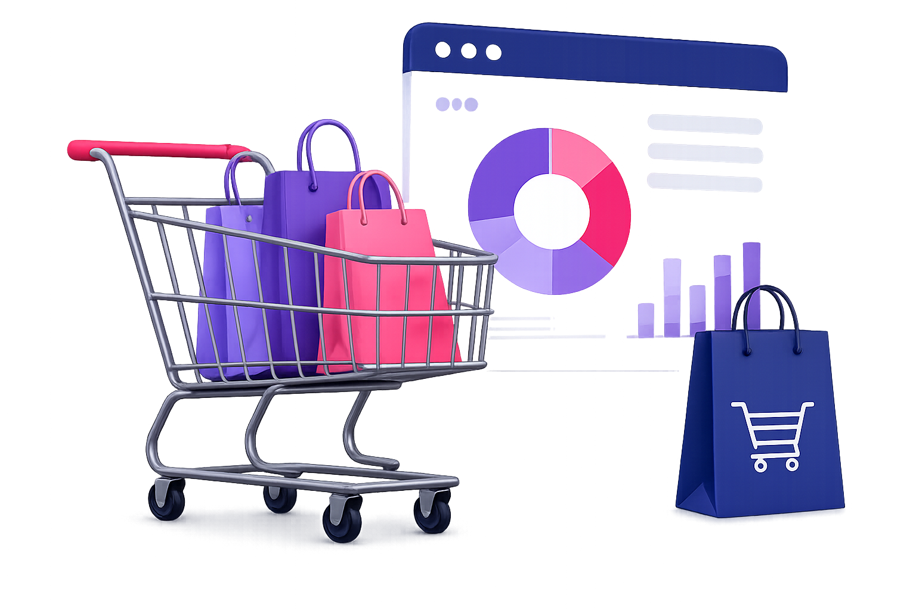


DATA BACKGROUND
Problem Statement
Key issues in understanding online shopping behavior
Customer Profile Confusion
01
Unclear buyer segments
Weak customer targeting
Unclear Shopping Habits
02
Device & time preference
unknown
Less effective promotions
Low Satisfaction & Retention
03
Unmet customer expectations
Higher returns & weaker loyalty
4

Slide 5
RESEARCH DIRECTION
Objectives & Research Questions
Research Objective
Research Question
RQ1
What is the most common age group and gender among the customers?
RO1
To analyse the demographic and socio-economic
profiles of the customer
RQ2
Which occupation group has the highest number of shoppers?
RQ3
Which location area has the highest number of shoppers?
RQ4
What is the distribution of income levels among customers?
To determine the patterns of purchasing activities
based on different shopping behaviour
RQ5
Which devices do customers prefer to use most of the time?
RO2
RQ6
What is the most popular payment method used by customers when they shop?
RQ7
At what time of the day and time in hour do the most purchase happen?
RQ8
What is the total sales across different month and year?
RQ9
How does product rating and customer satisfaction relate to return behaviour of customer?
To identify customer behaviour patterns that can
help improving customer service and reduce
return product related issue
RO3
RQ10
How do discount sensitivity and decision speed influence customer purchasing behaviour?
RQ11
Which purchase channels are most related with customer complaints?
RQ12
How do shipping preferences related to customer purchase intent?
5

Slide 6

RESEARCH DIRECTION
Methodology
Source of Raw Data
Data Cleansing and Data Preparation
Data Issues
Kaggle Website (2025)
30 attributes
12,370 rows
19 nominal, 5 ordinal, 4 interval, 2 ratio and 2 discrete.
Number of variables may complicate interpretation
Similar average values reduces interpretative strength
Potential sampling bias
Handling data errors and removes missing values
Standardized data format
Derivates Attributes
Derivatives Attributes
Purchase Bucket (Morning, Afternoon, Evening, Night)
Age Group (1, 2, 3)
Decision Speed (Slow, Moderate, Fast)
6

Slide 7








DATA CONTEXT
This dataset provides a comprehensive snapshot of individual consumer interactions in an online purchase environment
1
2
1. DEMOGRAPHIC &
SOCIO-ECONOMIC PROFILES
2. PURCHASING &
TRANSANCTION HABITS
CUSTOMER SATISFACTION
& BEHAVIOUR
Product Category
Purchase Amount
Purchase Frequency
Purchase Channel
Device Used
Payment Method
Discount Used
Time of Purchase
Customer satisfaction
Product Rating
Brand Loyalty
Purchase Intent
Decision time
Return rate
Time spent on product research
Age
Gender
Marital status
Education level
Occupation
Income level
Location
3
4
Synthetic Dataset
(Kaggle)
Customer from
United States
Notes:
Based on the dashboard, we suggest four actions. First, improve product information to reduce wrong expectations. Second, optimize the mobile shopping experience because smartphone usage is high. Third, use targeted promotions, especially in the morning and for slow decision-makers. Fourth, reduce return rate by improving support and product accuracy. The main message is that e-commerce success is about the full customer journey, not sales only.

Slide 8


TARGET USER OF THE DASHBOARD
What are the story behind the dashboard?
Sales & Marketing Department
Customer Service Department
Shows who the customers are, where sales happen, which devices they use and how they pay.
Shows decision speed, satisfaction, return rate, discount sensitivity, purchase channel and shipping preference.
Notes:
The central question for our dashboard is: what happens before, during, and after a customer clicks buy? We divide the story into two dashboards. Sales and marketing explain the business and customer profile. Customer service explains experience, satisfaction and returns.

Slide 9
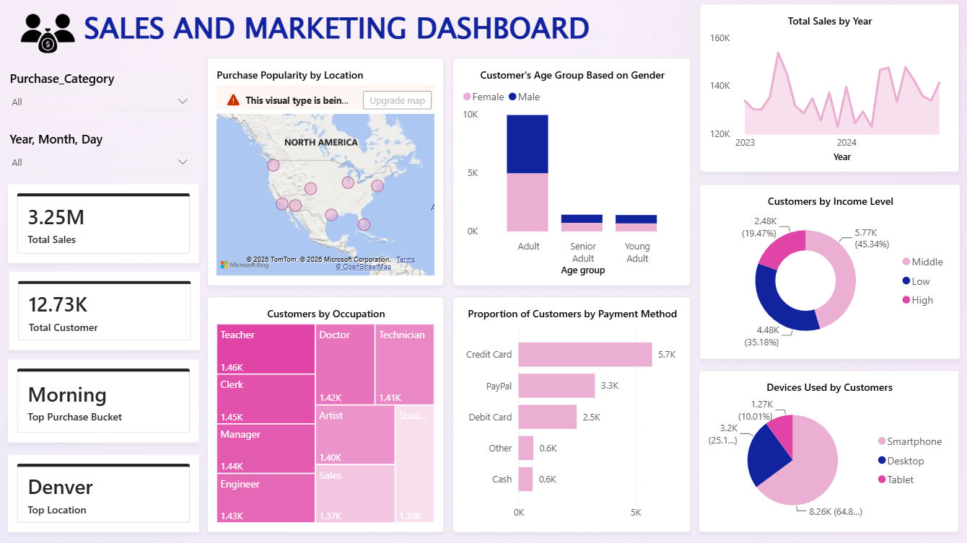
Notes:
First, we start with the Sales and Marketing Dashboard. It shows that the business has 12.73K customers and 11.028K purchase frequency. Denver is the top location and morning is the top purchase bucket. This means the business already has active customer behaviour and a clear target market.

Slide 10
Notes:
First, we start with the Sales and Marketing Dashboard. It shows that the business has 12.73K customers and 11.028K purchase frequency. Denver is the top location and morning is the top purchase bucket. This means the business already has active customer behaviour and a clear target market.

Slide 11
Notes:
First, we start with the Sales and Marketing Dashboard. It shows that the business has 12.73K customers and 11.028K purchase frequency. Denver is the top location and morning is the top purchase bucket. This means the business already has active customer behaviour and a clear target market.

Slide 12
Notes:
First, we start with the Sales and Marketing Dashboard. It shows that the business has 12.73K customers and 11.028K purchase frequency. Denver is the top location and morning is the top purchase bucket. This means the business already has active customer behaviour and a clear target market.

Slide 13
Notes:
First, we start with the Sales and Marketing Dashboard. It shows that the business has 12.73K customers and 11.028K purchase frequency. Denver is the top location and morning is the top purchase bucket. This means the business already has active customer behaviour and a clear target market.

Slide 14
Notes:
First, we start with the Sales and Marketing Dashboard. It shows that the business has 12.73K customers and 11.028K purchase frequency. Denver is the top location and morning is the top purchase bucket. This means the business already has active customer behaviour and a clear target market.

Slide 15
Notes:
First, we start with the Sales and Marketing Dashboard. It shows that the business has 12.73K customers and 11.028K purchase frequency. Denver is the top location and morning is the top purchase bucket. This means the business already has active customer behaviour and a clear target market.

Slide 16
Notes:
First, we start with the Sales and Marketing Dashboard. It shows that the business has 12.73K customers and 11.028K purchase frequency. Denver is the top location and morning is the top purchase bucket. This means the business already has active customer behaviour and a clear target market.

Slide 17
Notes:
First, we start with the Sales and Marketing Dashboard. It shows that the business has 12.73K customers and 11.028K purchase frequency. Denver is the top location and morning is the top purchase bucket. This means the business already has active customer behaviour and a clear target market.

Slide 18
DASHBOARD 2:
CUSTOMER SERVICE DASHBOARD

Slide 19
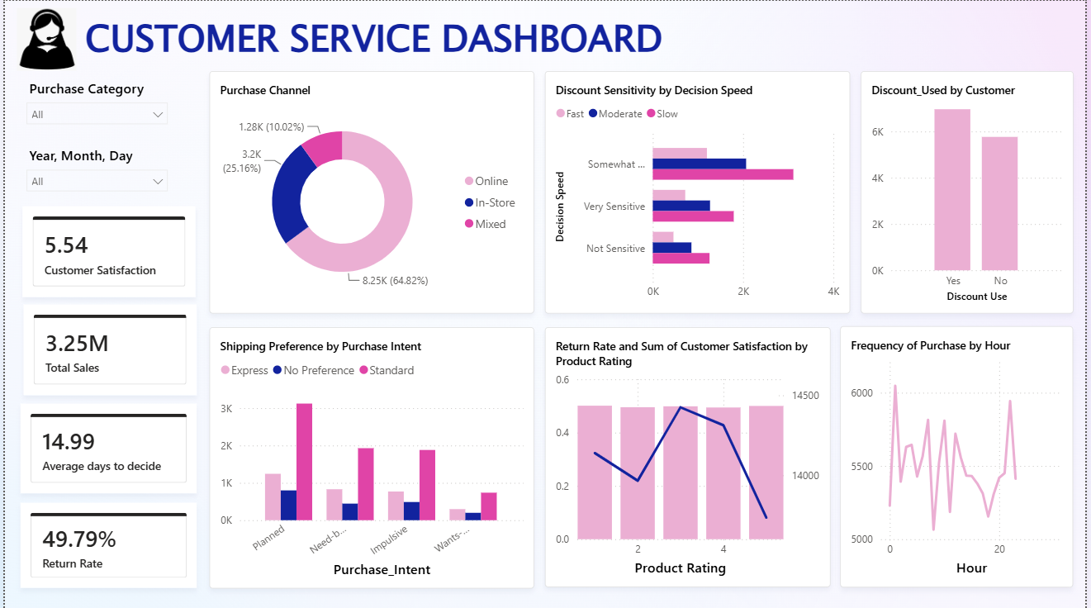
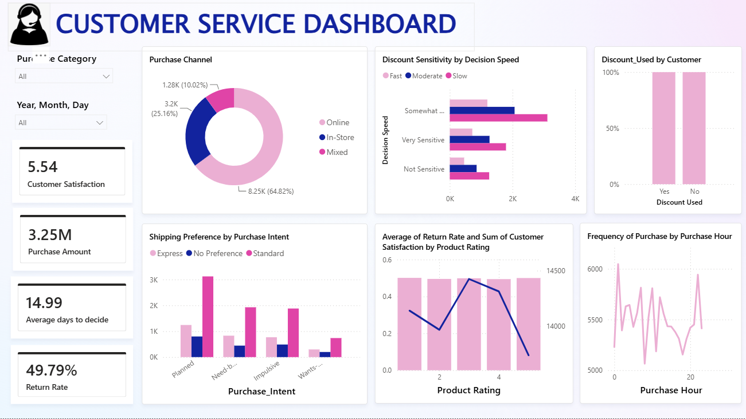
PART 2: CUSTOMER EXPERIENCE
Notes:
After analysing sales and marketing, we move to the Customer Service Dashboard. This dashboard shows the customer experience side. Customer satisfaction is 5.54, average days to decide is 14.99, and return rate is 49.79%. This is important because even if the business has sales growth, high returns can reduce profit and trust.

Slide 20
PART 2: CUSTOMER EXPERIENCE
Notes:
After analysing sales and marketing, we move to the Customer Service Dashboard. This dashboard shows the customer experience side. Customer satisfaction is 5.54, average days to decide is 14.99, and return rate is 49.79%. This is important because even if the business has sales growth, high returns can reduce profit and trust.

Slide 21
PART 2: CUSTOMER EXPERIENCE
Notes:
After analysing sales and marketing, we move to the Customer Service Dashboard. This dashboard shows the customer experience side. Customer satisfaction is 5.54, average days to decide is 14.99, and return rate is 49.79%. This is important because even if the business has sales growth, high returns can reduce profit and trust.

Slide 22
PART 2: CUSTOMER EXPERIENCE
Notes:
After analysing sales and marketing, we move to the Customer Service Dashboard. This dashboard shows the customer experience side. Customer satisfaction is 5.54, average days to decide is 14.99, and return rate is 49.79%. This is important because even if the business has sales growth, high returns can reduce profit and trust.

Slide 23
PART 2: CUSTOMER EXPERIENCE
Notes:
After analysing sales and marketing, we move to the Customer Service Dashboard. This dashboard shows the customer experience side. Customer satisfaction is 5.54, average days to decide is 14.99, and return rate is 49.79%. This is important because even if the business has sales growth, high returns can reduce profit and trust.

Slide 24
PART 2: CUSTOMER EXPERIENCE
Notes:
After analysing sales and marketing, we move to the Customer Service Dashboard. This dashboard shows the customer experience side. Customer satisfaction is 5.54, average days to decide is 14.99, and return rate is 49.79%. This is important because even if the business has sales growth, high returns can reduce profit and trust.

Slide 25
PART 2: CUSTOMER EXPERIENCE
Notes:
After analysing sales and marketing, we move to the Customer Service Dashboard. This dashboard shows the customer experience side. Customer satisfaction is 5.54, average days to decide is 14.99, and return rate is 49.79%. This is important because even if the business has sales growth, high returns can reduce profit and trust.

Slide 26
PART 2: CUSTOMER EXPERIENCE
Notes:
After analysing sales and marketing, we move to the Customer Service Dashboard. This dashboard shows the customer experience side. Customer satisfaction is 5.54, average days to decide is 14.99, and return rate is 49.79%. This is important because even if the business has sales growth, high returns can reduce profit and trust.

Slide 27
Process
Converted raw transaction data into interactive and meaningful visualisations for easier analysis and interpretation.
CONCLUSION
Achieve all three objectives
Customer demographic and socio-economic profiles.
Customer purchasing behaviour and sales performance.
Post-purchase behaviour, customer satisfaction and product return factors.
Visualization impact
Reduced the time and effort required for manual analysis through interactive dashboards and filtering capabilities.
Notes:
The most important warning signal is the return rate. It is 49.79%, which means almost half of purchases are returned. This is a serious issue because returns can affect profit, delivery cost, inventory and customer loyalty. At the same time, customers take almost 15 days to decide, so they may be uncertain before buying.

Slide 28
INSIGHT 4: POSSIBLE CAUSES
Exploring The Customer Behavior
The dashboard cannot prove the exact reason, but it gives clues.
Clue 1
Clue 2
Customers take time to decide
Discount sensitivity exists
Average decision time is 14.99 days, suggesting comparison, hesitation, or uncertainty.
Discount-sensitive customers may buy faster when promotions appear, but may later regret the purchase.
Clue 3
Clue 4
Standard shipping dominates
Satisfaction is moderate
Customers may prefer cost-saving delivery, but expectations still need to be managed clearly.
A satisfaction score of 5.54 suggests room to improve product information and post-purchase support.
Important: present these as dashboard-based interpretations, not as final causal proof.
Notes:
For the creative part, we use a data detective slide. The dashboard gives clues, not final proof. Customers take 14.99 days to decide, discount sensitivity exists, standard shipping is popular and satisfaction is moderate. These clues suggest that customers may feel uncertain, buy because of promotion, or have expectations that are not fully met after purchase.

